Slide 1
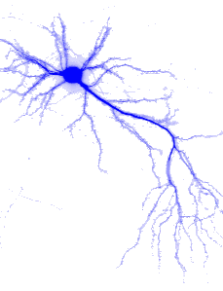
Feed-Forward Neural Networks
Multi Layer Neural Networks
Output Values
Input Signals (External Stimuli)

Slide 2


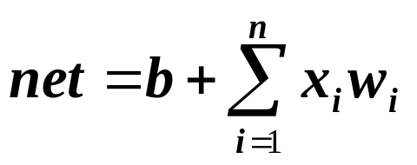


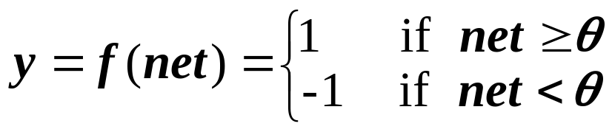
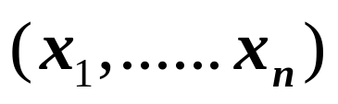
General architecture
Single layer
net input to Y:
bias b is treated as the weight from a special unit with constant output 1.
threshold related to Y
output
classify into one of the two classes
1
x1
Y
xn

Slide 3

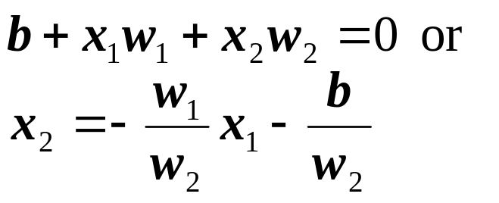

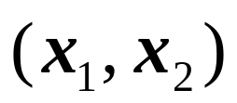
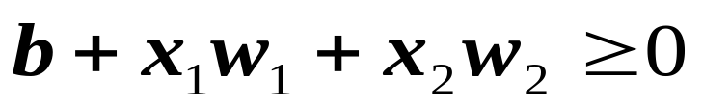
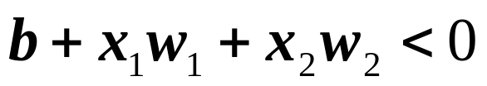
Decision region/boundary
  n = 2,
  b != 0,
  θ = 0
  is a line, called decision boundary, which partitions the plane into two decision regions
  If a point/pattern is in the positive region, then
  , and the output is one (belongs to class one)
  Otherwise, ,output –1 (belongs to class two)
  n = 2, b = 0, θ != 0 would result a similar partition
+
-

Slide 4
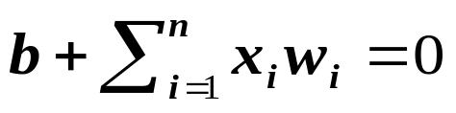
  If n = 3 (three input units), then the decision boundary is a two dimensional plane in a three dimensional space
  In general, a decision boundary
  is a n-1 dimensional hyper-plane in an n dimensional space, which partition the space into two decision regions
  This simple network thus can classify a given pattern into one of the two classes, provided one of these two classes is entirely in one decision region (one side of the decision boundary) and the other class is in another region.
  The decision boundary is determined completely by the weights W and the bias b (or threshold θ).

Slide 5
Linear Separability Problem
If two classes of patterns can be separated by a decision boundary, represented by the linear equation
then they are said to be linearly separable. The simple network can correctly classify any patterns.
Decision boundary (i.e., W, b or θ) of linearly separable classes can be determined either by some learning procedures or by solving linear equation systems based on representative patterns of each classes
If such a decision boundary does not exist, then the two classes are said to be linearly inseparable.
Linearly inseparable problems cannot be solved by the simple network , more sophisticated architecture is needed.

Slide 6
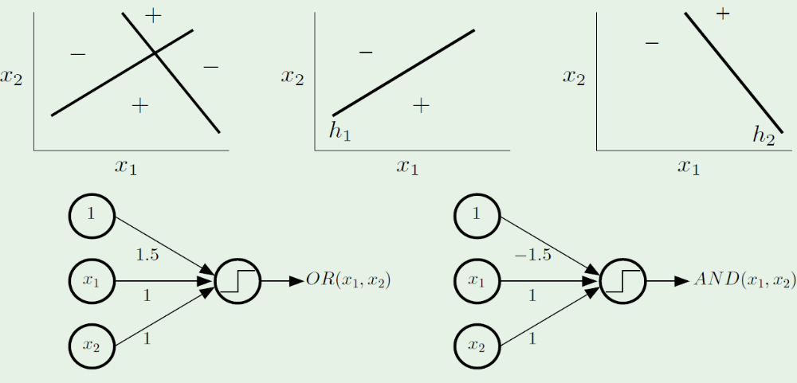
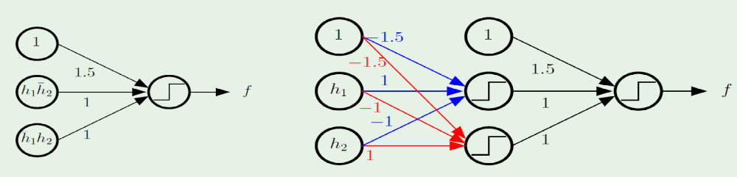
Combining Perceptrons

Slide 7
  XOR can be solved by a more complex network with hidden units
θ = 1
x1
2
z1
2
θ = 0
-2
Y
-2
x2
z2
2
2
(-1, -1) (-1, -1) -1
(-1, 1) (-1, 1) 1
(1, -1) (1, -1) 1
(1, 1) (1, 1) -1

Slide 8
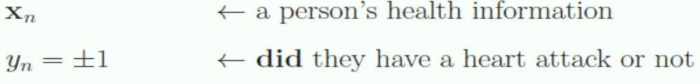
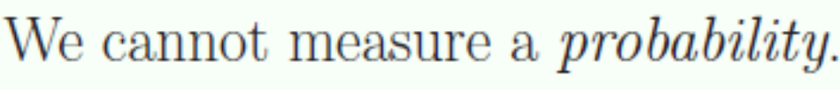
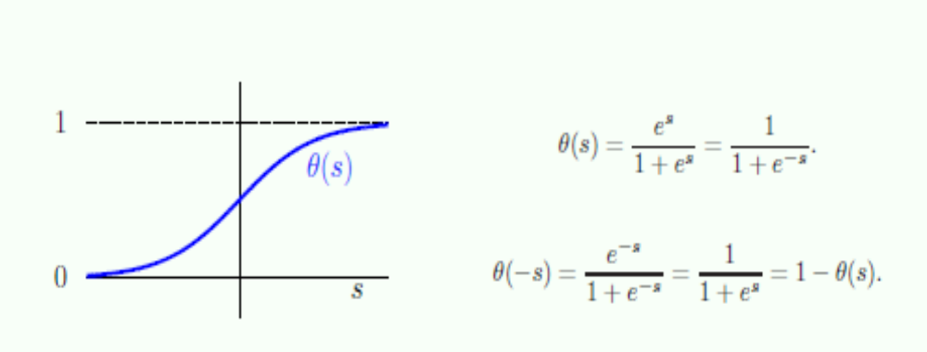
Sigmoid function
The Data still Binary (+1 , -1)

Slide 9
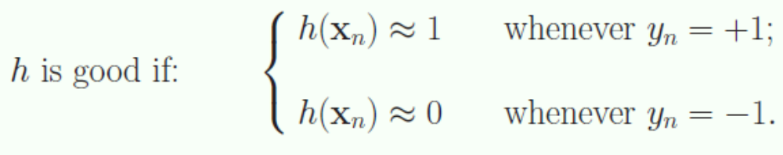
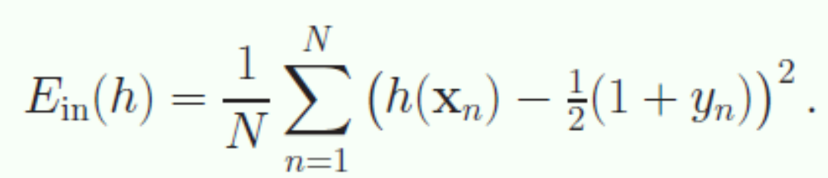
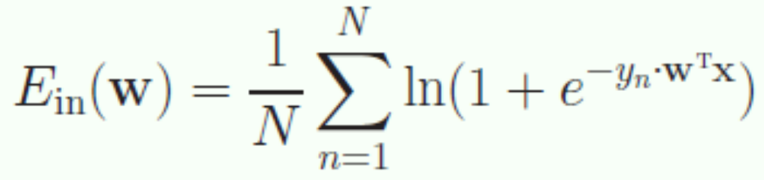
Good Hypothesis h
A simple Error
Better One (Cross Entropy)

Slide 10
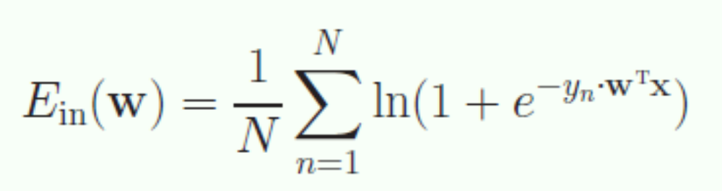
The Cross entropy error measure
Based on an intuitive probabilistic
interpretation of h
Mathematically friendly
easy to minimize

Slide 11
Feed-Forward Neural Networks
Single-Layer Perceptron Networks

Slide 12
The Single-Layered Perceptron
y₁
y₂
. . .
y_{n}
. . .
w_{1m}
w_{2m}
w_{n1}
w₁₂
w₂₂
w_{n2}
w₁₁
w₂₁
w_{nm}
. . .
x₁
x₂
x_{m-1}
x_{m}= −1

Slide 13
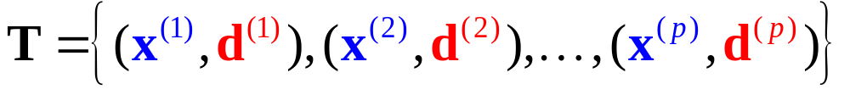


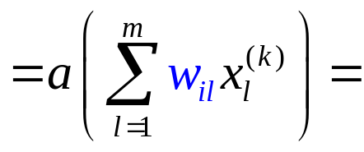

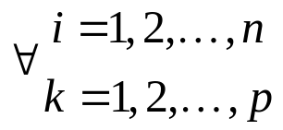
Training a Single-Layered Perceptron
Training Set
y₁
y₂
. . .
y_{n}
Goal:
d₁
d₂
d_{n}
. . .
w_{1m}
w_{2m}
w_{n1}
w₁₂
w₂₂
w_{n2}
w₁₁
w₂₁
w_{nm}
. . .
x₁
x₂
x_{m-1}
x_{m}= −1

Slide 14
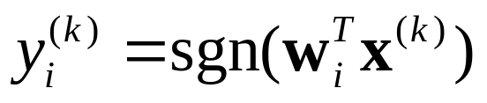
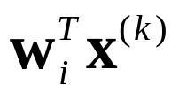
Perceptron
Linear Threshold Unit
x₁
w_{i1}
x₂
sgn
w_{i2}
∑
.
.
.
+1
−1
w_{im} =θ_{i}
x_{m}= −1

Slide 15
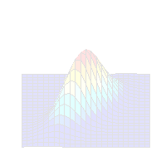
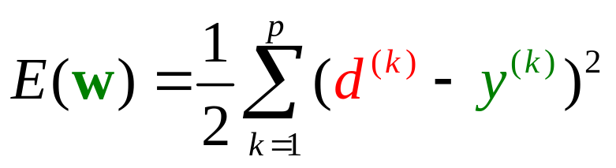
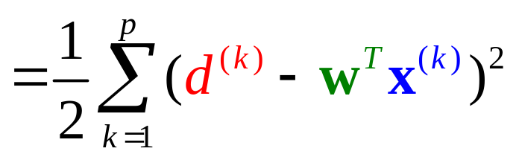
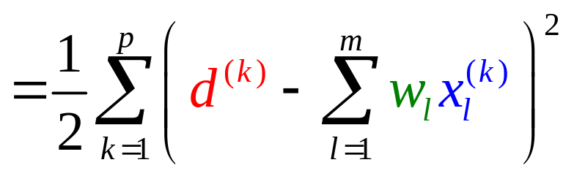
LMS (Least Mean Square)
Minimize the cost function (error function):

Slide 16
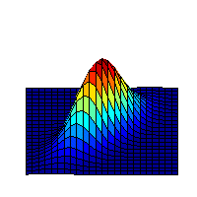
Our goal is to go downhill.
Gradient Decent Algorithm
E(w)
w₂
Contour Map
Δw
Δw₂
(w₁, w₂)
w₁
Δw₁

Slide 17
Our goal is to go downhill.
Gradient Decent Algorithm
How to find the steepest decent direction?
E(w)
w₂
Contour Map
Δw
Δw₂
(w₁, w₂)
w₁
Δw₁

Slide 18
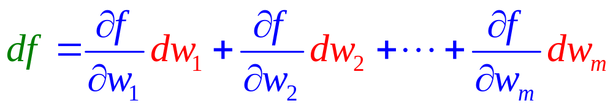
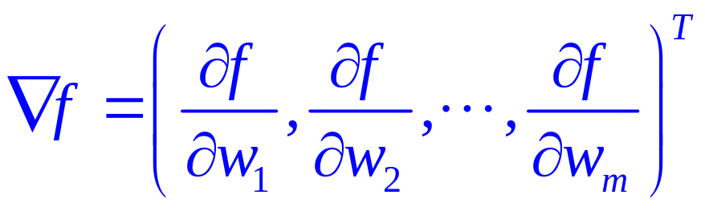
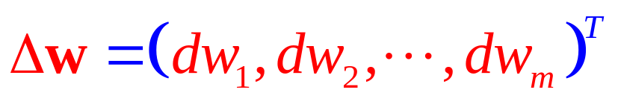
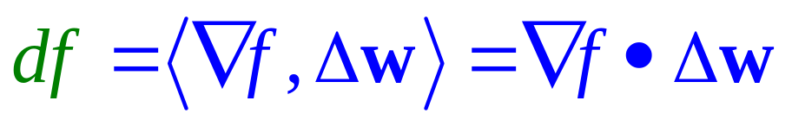
Gradient Operator
Let f(w) = f (w₁, w₂,…, w_{m}) be a function over R^{m}.
Define

Slide 19
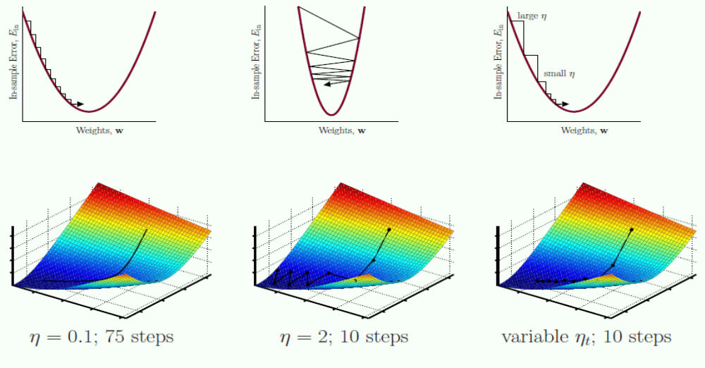
The best step size

Slide 20
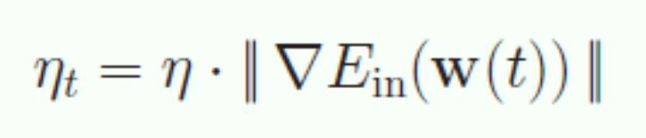
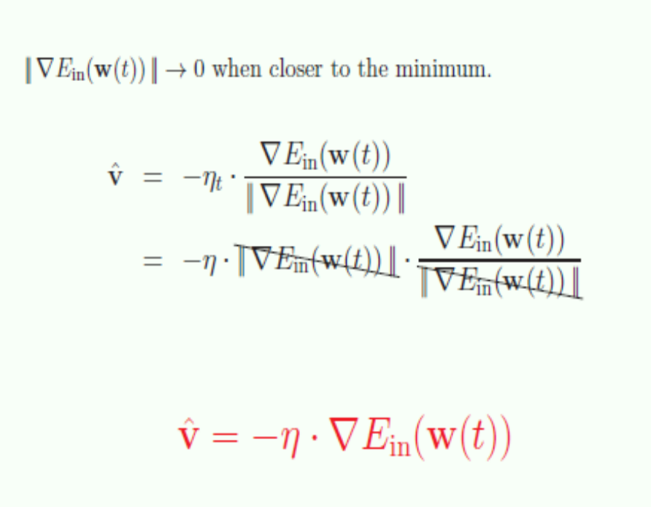
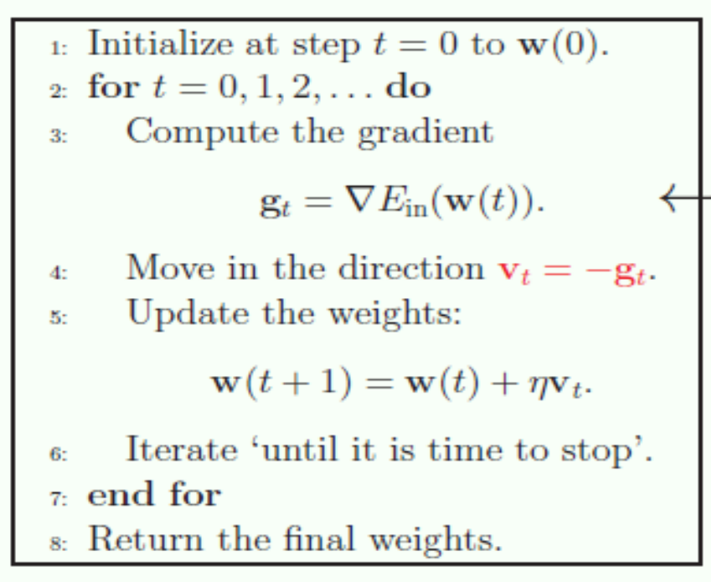
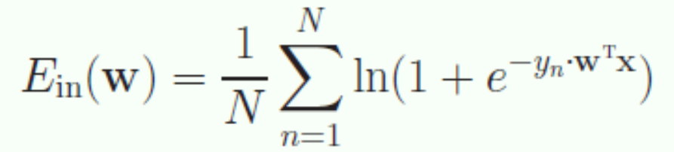
Fixed Learning rate GD
GD can minimize any
smooth function

Slide 21
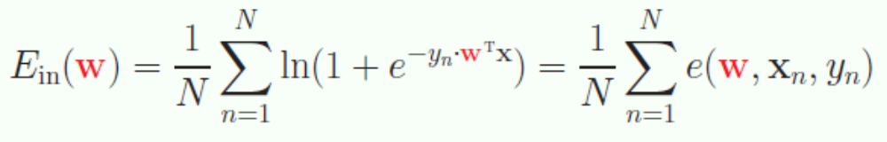
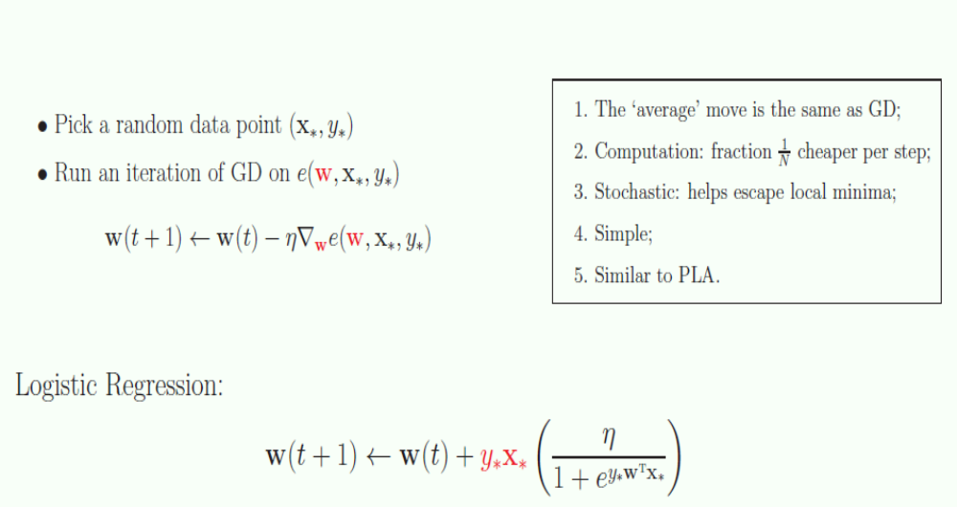
Stochastic GD
A variation pf GD considering only one point each step

Slide 22
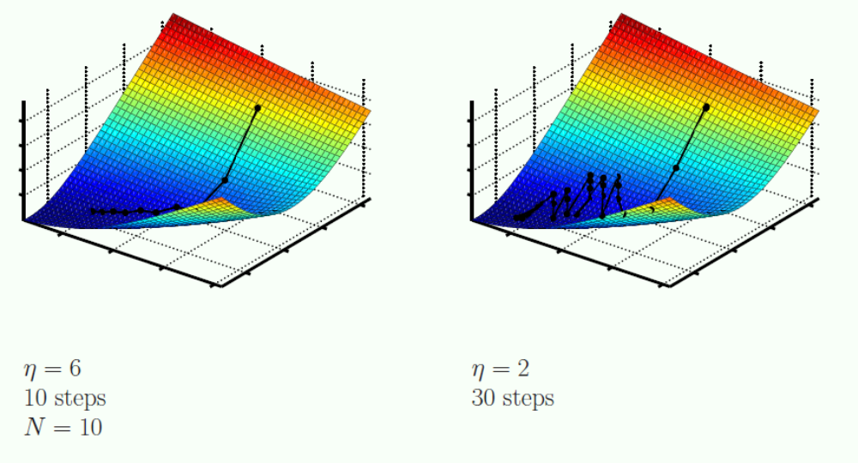
Stochastic Gradient Descent
GD
Stochastic GD

Slide 23
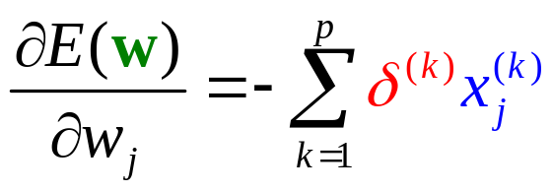

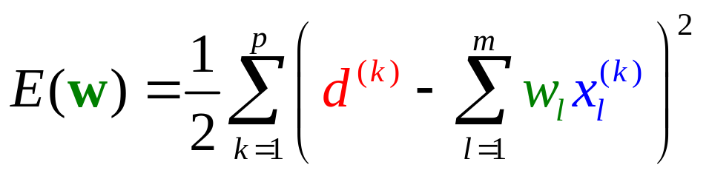
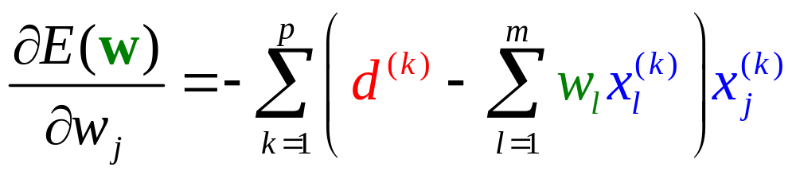
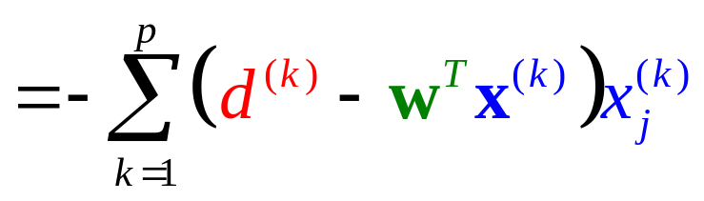
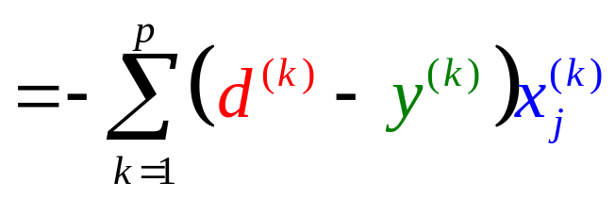
LMS (Least Mean Square)
Minimize the cost function (error function):
δ ^{(k)}

Slide 24
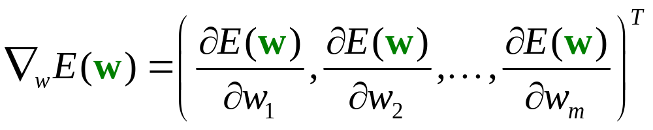

Adaline Learning Rule
Minimize the cost function (error function):
Weight Modification Rule

Slide 25
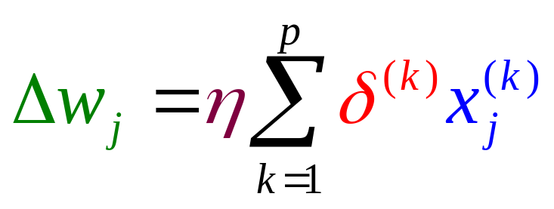
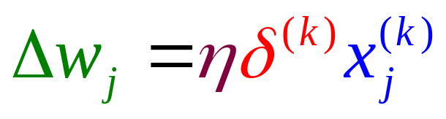
Learning Modes
Batch Learning Mode:
Incremental Learning Mode:

Slide 26
Feed-Forward Neural Networks
Learning Rules for
Single-Layered Perceptron Networks
Perceptron Learning Rule
Adaline Leaning Rule
δ-Learning Rule

Slide 27
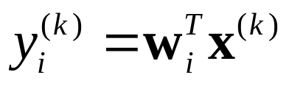
Adaline
x₁
w_{i1}
x₂
w_{i2}
∑
.
.
.
w_{im}
x_{m}

Slide 28
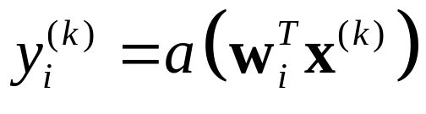

Unipolar Sigmoid
x₁
w_{i1}
x₂
w_{i2}
∑
.
.
.
w_{im}
x_{m}

Slide 29

Bipolar Sigmoid
x₁
w_{i1}
x₂
w_{i2}
∑
.
.
.
w_{im}
x_{m}

Slide 30

Goal
Minimize

Slide 31

Gradient Decent Algorithm
Minimize

Slide 32






The Gradient
Minimize
Depends on the activation function used.
?
?

Slide 33





Weight Modification Rule
Minimize
Batch
Learning Rule
Incremental

Slide 34






The Learning Efficacy
Minimize
Sigmoid
Adaline
Unipolar
Bipolar

Slide 35



Learning Rule − Unipolar Sigmoid
Minimize
Weight Modification Rule

Slide 36





Comparisons
Batch
Adaline
Incremental
Batch
Sigmoid
Incremental

Slide 37

The Learning Efficacy
Adaline
Sigmoid
y=a(net) = net
y=a(net)
net
net
constant
depends on output

Slide 38
The Learning Efficacy
Adaline
Sigmoid
The learning efficacy of Adaline is constant meaning that the Adline will never get saturated.
y=a(net) = net
y=a(net)
a’(net)
net
1
net
y=net
constant
depends on output

Slide 39

The Learning Efficacy
The sigmoid will get saturated if its output value nears the two extremes.
Sigmoid
Adaline
y=a(net) = net
y=a(net)
a’(net)
net
net
0
1
y
depends on output
constant

Slide 40
Initialization for Sigmoid Neurons
Before training, it weight must be sufficiently small.
Why?
x₁
w_{i1}
x₂
w_{i2}
∑
.
.
.
w_{im}
x_{m}

Slide 41
Feed-Forward Neural Networks
Multilayer Perceptron

Slide 42

Multilayer Perceptron
y₁
y₂
y_{n}
Output Layer
. . .
Hidden Layer
. . .
. . .
Input Layer
. . .
x₁
x₂
x_{m}

Slide 43




Multilayer Perceptron
Where the knowledge from?
Classification
Output
Analysis
Learning
Input

Slide 44
How an MLP Works?
Example:
Not linearly separable.
Is a single layer perceptron workable?
XOR
x₂
1
0
x₁
1

Slide 45
Combining Perceptrons

Slide 46

The Multi Layer Perceptron – 3 Layers

Slide 47

Powerful model
Optimization ? Generalization ?

Slide 48
General Problem

Slide 49
Hyperspace Partition
L₃
L₁
L₂

Slide 50
Feed-Forward Neural Networks
Back Propagation Learning algorithm

Slide 51




Activation Function — Sigmoid
1
0.5
net
0
Remember this

Slide 52


Activation functions
Transforms neuron’s input into output.
Features of activation functions:
  A squashing effect is required
    Prevents accelerating growth of activation levels through the network.
  Simple and easy to calculate
1
1
0
Sign
0
Hyperbolic
y
-1
-1
0
1
0
Rectifier
0.5
Gaussian
y
z
0
0
0

Slide 53
Standard activation functions
The hard-limiting threshold function
  Corresponds to the biological paradigm
    either fires or not
Sigmoid functions ('S'-shaped curves)
  The logistic function
  The hyperbolic tangent (symmetrical)
  Both functions have a simple differential
  Only the shape is important
1
φ(x) =
1 + e ^{-ax}

Slide 54


Logistic neurons
These give a real-valued output that is a smooth and bounded function of their total input.
  They have nice derivatives which make learning easy.
1
0.5
0
0

Slide 55





The derivatives of a logistic neuron
The derivative of the output with respect to the logit is simple if you express it in terms of the output:
The derivatives of the logit, z, with respect to the inputs and the weights are very simple:

Slide 56



The derivatives of a logistic neuron
because

Slide 57

Standard Activation Functions

Slide 58

The Multi Layer Perceptron

Slide 59
Training Set
Supervised Learning
o₁
o₂
o_{n}
d₁
d₂
d_{n}
Output Layer
. . .
Hidden Layer
. . .
. . .
Input Layer
. . .
x₁
x₂
x_{m}

Slide 60


Training Set
Supervised Learning
Sum of Squared Errors
o₁
o₂
o_{n}
d₁
d₂
d_{n}
. . .
. . .
Goal:
. . .
Minimize
. . .
x₁
x₂
x_{m}

Slide 61
Back Propagation Learning Algorithm
o₁
o₂
o_{n}
d₁
d₂
d_{n}
Learning on Output Neurons
Learning on Hidden Neurons
. . .
. . .
. . .
. . .
x₁
x₂
x_{m}

Slide 62




Learning on Output Neurons
o₁
o_{j}
o_{n}
d₁
d_{j}
d_{n}
. . .
j
. . .
w_{ji}
. . .
i
. . .
. . .
. . .
?
?
. . .
. . .

Slide 63


Learning on Output Neurons
o₁
o_{j}
o_{n}
d₁
d_{j}
d_{n}
. . .
j
. . .
w_{ji}
. . .
i
. . .
. . .
. . .
. . .
. . .
depends on the activation function

Slide 64


Learning on Output Neurons
o₁
o_{j}
o_{n}
d₁
d_{j}
d_{n}
. . .
j
. . .
w_{ji}
. . .
i
. . .
. . .
. . .
. . .
. . .
Using sigmoid,

Slide 65


Learning on Output Neurons
o₁
o_{j}
o_{n}
d₁
d_{j}
d_{n}
. . .
j
. . .
w_{ji}
. . .
i
. . .
. . .
. . .
. . .
. . .
Using sigmoid,

Slide 66



Learning on Output Neurons
o₁
o_{j}
o_{n}
d₁
d_{j}
d_{n}
. . .
j
. . .
w_{ji}
. . .
i
. . .
. . .
. . .
. . .
. . .

Slide 67


Learning on Output Neurons
o₁
o_{j}
o_{n}
d₁
d_{j}
d_{n}
. . .
j
. . .
How to train the weights connecting to output neurons?
w_{ji}
. . .
i
. . .
. . .
. . .
. . .
. . .

Slide 68


Learning on Hidden Neurons
. . .
j
. . .
w_{ji}
. . .
i
. . .
?
?
w_{ik}
. . .
k
. . .
. . .
. . .

Slide 69


Learning on Hidden Neurons
. . .
j
. . .
w_{ji}
. . .
i
. . .
w_{ik}
. . .
k
. . .
. . .
. . .

Slide 70


Learning on Hidden Neurons
. . .
j
. . .
w_{ji}
. . .
i
. . .
w_{ik}
. . .
k
. . .
?
. . .
. . .

Slide 71




Learning on Hidden Neurons
. . .
j
. . .
w_{ji}
. . .
i
. . .
w_{ik}
. . .
k
. . .
. . .
. . .

Slide 72


Learning on Hidden Neurons
. . .
j
. . .
w_{ji}
. . .
i
. . .
w_{ik}
. . .
k
. . .
. . .
. . .

Slide 73
Back Propagation
o₁
o_{j}
o_{n}
d₁
d_{j}
d_{n}
. . .
j
. . .
. . .
i
. . .
. . .
k
. . .
. . .
. . .
x₁
. . .
x_{m}

Slide 74

Back Propagation
o₁
o_{j}
o_{n}
d₁
d_{j}
d_{n}
. . .
j
. . .
. . .
i
. . .
. . .
k
. . .
. . .
. . .
x₁
. . .
x_{m}

Slide 75

Back Propagation
o₁
o_{j}
o_{n}
d₁
d_{j}
d_{n}
. . .
j
. . .
. . .
i
. . .
. . .
k
. . .
. . .
. . .
x₁
. . .
x_{m}

Slide 76

Learning Algorithm:
Backpropagation
Pictures below illustrate how signal is propagating through the network, Symbols w_{(xm)n} represent weights of connections between network input x_{m} and neuron n in input layer. Symbols y_{n} represents output signal of neuron n.

Slide 77

Learning Algorithm:
Backpropagation

Slide 78

Learning Algorithm:
Backpropagation

Slide 79

Learning Algorithm:
Backpropagation
Propagation of signals through the hidden layer. Symbols w_{mn} represent weights of connections between output of neuron m and input of neuron n in the next layer.

Slide 80
Learning Algorithm:
Backpropagation

Slide 81

Learning Algorithm:
Backpropagation

Slide 82

Learning Algorithm:
Backpropagation
Propagation of signals through the output layer.

Slide 83

Learning Algorithm:
Backpropagation
In the next algorithm step the output signal of the network y is compared with the desired output value (the target), which is found in training data set. The difference is called error signal d of output layer neuron

Slide 84

Learning Algorithm:
Backpropagation
The idea is to propagate error signal d (computed in single teaching step) back to all neurons, which output signals were input for discussed neuron.

Slide 85

Learning Algorithm:
Backpropagation
The idea is to propagate error signal d (computed in single teaching step) back to all neurons, which output signals were input for discussed neuron.

Slide 86

Learning Algorithm:
Backpropagation
The weights' coefficients w_{mn} used to propagate errors back are equal to this used during computing output value. Only the direction of data flow is changed (signals are propagated from output to inputs one after the other). This technique is used for all network layers. If propagated errors came from few neurons they are added. The illustration is below:

Slide 87



Slide 88

Learning Algorithm:
Backpropagation
When the error signal for each neuron is computed, the weights coefficients of each neuron input node may be modified. In formulas below df(e)/de represents derivative of neuron activation function (which weights are modified).
For Segmoid activation function df(e)/de is f1*(1-f1) where f1 = σ ( X1* w(x1)1 + X2*w(x2)1)

Slide 89

Learning Algorithm:
Backpropagation
When the error signal for each neuron is computed, the weights coefficients of each neuron input node may be modified. In formulas below df(e)/de represents derivative of neuron activation function (which weights are modified).

Slide 90

Learning Algorithm:
Backpropagation

Slide 91

Learning Algorithm:
Backpropagation

Slide 92

Learning Algorithm:
Backpropagation

Slide 93

Learning Algorithm:
Backpropagation
When the error signal for each neuron is computed, the weights coefficients of each neuron input node may be modified. In formulas below df(e)/de represents derivative of neuron activation function (which weights are modified).

Slide 94
Neural Network Problems
Many Parameters to be set
Overfitting
long training times
...

Slide 95
Parameter setting
Number of layers
Number of neurons
    too many neurons, require more training time
Learning rate
    from experience, value should be small ~0.1
Momentum term
..

Slide 96
Over-fitting
With sufficient nodes can classify any training set exactly
May have poor generalisation ability.
Cross-validation with some patterns
  Typically 30% of training patterns
  Validation set error is checked each epoch
  Stop training if validation error goes up

Slide 97

Training time
How many epochs of training?
  Stop if the error fails to improve (has reached a minimum)
  Stop if the rate of improvement drops below a certain level
  Stop if the error reaches an acceptable level
  Stop when a certain number of epochs have passed

Slide 98
Learning Factors
Initial Weights
Learning Constant (η)
Cost Functions
Momentum
Update Rules
Training Data and Generalization
Number of Layers
Number of Hidden Nodes

